Slide 1
CS 201 Introduction to Computing
Spring 2022-2023
Notes:
deneme

Slide 2
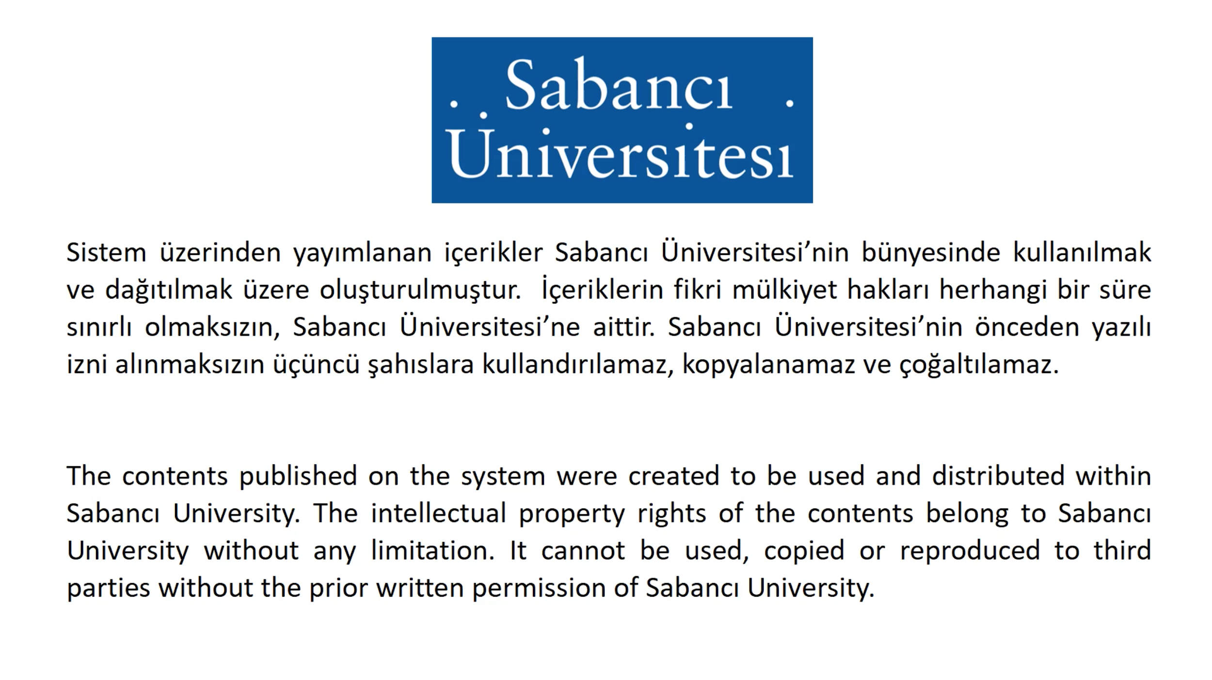

Slide 3
Week-4 (Part 1)
Introduction to classes and objects
Using the existing string class
Textbook Sections 3.4 and 4.6

Slide 4
MIDTERM WILL BE ON 24/04/2023
19:40-21:30

Slide 5
Introduction to Classes and Objects
In object-oriented programming terminology, a class is defined as a kind of programmer-defined type
Natural language definition of the word "class":
Collection of members that share certain attributes and functionality
Likewise, classes in object-oriented programming
In object oriented PLs (like C++), classes are used to combine everything for a concept (like date, student)
Data (state) (e.g. student id, gpa)
Functions (behavior) (e.g. students enroll, students graduate)

Slide 6
Introduction to Classes and Objects
We define variables of types (like int, double) Similarly, we define objects of classes
an object is a member of a class
Why classes and objects? Why object-oriented programming?
Gives programmers the ability to write programs using off-the-shelf components without dealing with their complexity
Saves time and effort
Objects are how real-world entities are represented
You may design and implement, and later use your own classes, but we will start with using other-programmers-defined classes
this is what a programmer generally does

Slide 7
Where is a Class defined?
Class definition/interface (member function prototypes and some other declarations) is in a header file (.h file)
Function prototype includes function name, return type and parameters; function body is not there
A function’s prototype is its definition; it allows the program to call that function
Prototype definitions are generally used for library functions; function body is not known, but its interface must be known by the program in order to call that function
Prototype definitions can be used for user-defined functions too
Implementations of the member functions are in a .cpp file

Slide 8
How to use Classes?
The behavior of a class is defined by its member functions (methods) by which objects of that class are manipulated
You should know about member functions and what they do
name of the function
parameters and parameter types
return type
functionality
You don’t need to know how the function is implemented
analogy: you can add two int variables using +, but you don't need to know how computer really adds
more analogy: you can drive cars, but you don't need to know how the fuel injection works

Slide 9
string as a class
string is a class
string variables are objects, they're instances of the class
A string is a sequence of characters
first char is at position 0 → first index is 0
last valid index (position of the last character): string's length -1
Constructor: general name for object creating functions
without initialization
string mystr, s;
with initialization
string s = "Hello World";
string otherstring = s; or string otherstring(s);
You may use functions and operators that return strings in initialization
string s = "Hello" + "World"; // concatenation operator

Slide 10
How to
How to define objects?
do not forget arguments for each object, if any
How to call a member function?
a member function operates on an object for which it is called
class_name object_name_list_separated_by_comma;
object_name.function_name(arguments);

Slide 11
string member functions
The function length() returns the number of characters
Member functions are applied to objects using dot notation
Cannot use length() without an object to apply it to
Not valid int x = length(s);
Not valid int x = string.length();
Valid? double y = sqrt(s.length());
string s = "hello";
int len = s.length(); // value of len is 5
s = ""; // s is null string
len = s.length(); // value of len is 0

Slide 12
string member functions
int length()
// postcondition: returns the number of characters
string substr(int pos, int len)
// precondition: 0 <= pos, and pos < length of the string object
// postcondition: returns substring of len characters beginning at position
// pos. Returns as many characters as possible if len is too large, but
// causes error if pos is out of range (>= length of the string object)
int find(string s)
// postcondition: returns first position/index at which substring s begins in
// string object– returns string::npos if s does not occur
More details in "how to C" in Tapestry

Slide 13
Extracting substrings
A substring is part of a string, substrings can be extracted from a string using member function substr
See strdemo.cpp which is a sample program that uses length and substr functions
t
h
e
a
t
e
r
string s = "theater";
int len = s.length(); // value of len is 7
string t = s.substr(0,3); // t is "the", s is "theater"
t = s.substr(1,4); // t is now "heat"
s = s.substr(3,3); // s is "ate" t is still "heat"
s = "cinema";
t = s.substr(4,8); // t is "ma"
t = s.substr(8,2); // run-time error
0 1 2 3 4 5 6
c
i
n
e
m
a
0 1 2 3 4 5

Slide 14
substr with a single parameter
There is another version of substr that takes 1 parameter
This parameter is starting index for the substring to be extracted
In this version, substring till the end is returned
t
h
e
a
t
e
r
0 1 2 3 4 5 6
string s = "theater";
string t = s.substr(1); // t is "heater", s is "theater"
t = s.substr(4); // t is now "ter"

Slide 15
Finding substrings within strings: find & rfind
String member function find looks for an occurrence of one string (which is a parameter) in another (which is the object string), and returns position of the start of the first occurrence
If no occurrence, then string::npos is returned
rfind is same as find, but searches backwards, returns last occurrence
See strfind.cpp which is a sample program on find function
string s = "I am the eggman, he is too";
int k = s.find("I"); // k is 0
k = s.find("he"); // k is 6
k = s.find("egg"); // k is 9
k = s.find("a"); // k is 2
cout << s.find("cat"); // output is 4294967295
k = s.find("cat"); // k is –1
k = s.rfind("he"); // k is 17
k = s.rfind("egg"); // k is 9

Slide 16
find and rfind with 2 parameters
There are other versions of find and rfind that takes two parameters
First parameter is still a string (the search string)
Second parameter is an integer (an index value)
In this version, searching starts from the character for which the index is the second parameter of find or rfind
Useful when you need to search a string not from the endpoint, but from somewhere in the middle
string s = "I am the eggman, he is too";
int k;
k = s.find("a"); // k is 2
k = s.find("a",5); // k is 13
k = s.rfind("he"); // k is 17
k = s.rfind("he", 15); // k is 6

Slide 17
More on strings
You can append one string to the end of another
using operator +
You can change or extract one character of a string using at member function
parameter of at must be between 0 and string's length - 1, otherwise a run-time error occurs
string s = "cs201";
s = s + " is easy"; // s is now "cs201 is easy"
string s = "Hello World";
s.at(4) = '!'; // s is now "Hell! World"
cout << s.at(1) ; // displays e on screen
s.at(20) = 'a'; // run-time error

Slide 18
More on strings
You can also use [] notation instead of at member function string s = "cs201";
s[2] = '3'; // s becomes "cs301"
However, you should be careful !!! There is a difference! string s = "cs201";
s[s.length()] = '3'; // does not give runtime error
s.at(s.length()) = '3'; // gives runtime error
Therefore, we suggest you to use at member function. Usage of [] notation may produce some algorithmic errors that are really hard to detect.

Slide 19
More on strings
We already know how to compare strings
See "How to C"
insert and replace functions
String functions and operators we have seen so far are from standard C++ library
Tapestry also has some classes and utility functions
we will see and use them in time
strutils.h and strutils.cpp
Tapestry string utilities
include strutils.h at the beginning of the program
add strutils.cpp to your project
see "How to G"

Slide 20
Example (See stringremove.cpp)
Write a function that takes two string parameters (say s1 and s2). This function will remove the first occurrence of s2 in s1 and returns the resulting string. In the main program, test the function by removing some input strings from "Today is Monday".

Slide 21
Example (See stringremove.cpp)
string remove(string s1, string s2){
// post: Removes first occurrence of s2 from s1 and returns the
// resulting string. Returns s1 if s2 does not occur any.
int location;
string temp = s1;
location = s1.find(s2);
if (location != string::npos){
temp = s1.substr(0, location) +
s1.substr(location+s2.length(),s1.length());
}
return temp;
}

Slide 22
Free functions and member functions
The functions in <cmath> are free functions, they are not part of a class
C++ is a hybrid language, some functions belong to a class, others do not
Java and C# are pure object-oriented languages, every function belongs to a class
Similarly, IsLeapYear is also a free function
Any function that doesn't operate on an object is free function
However, length, substr, find are functions for string class
they are not free, they operate on strings only
that is why they are called member functions
all string functions are member functions

